Slide 1
ACTION OUTPUT SCREENSHOTS
MySQL
-creating database and tables
-inserting values
-select, where, group by, order by, Joins(inner, left, right) used
-create view

Slide 2
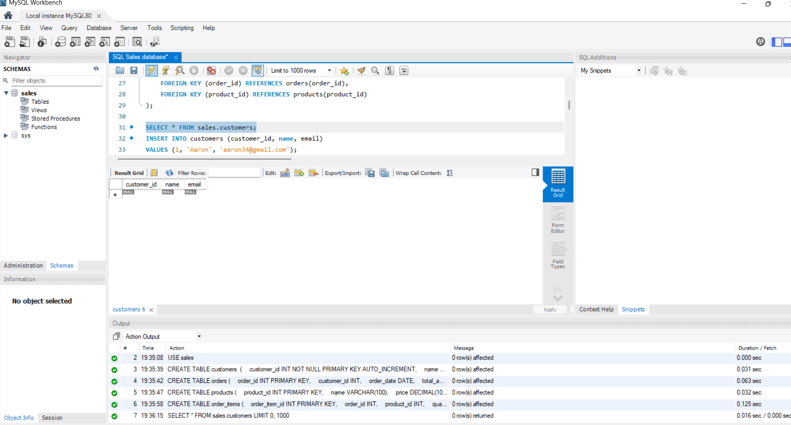
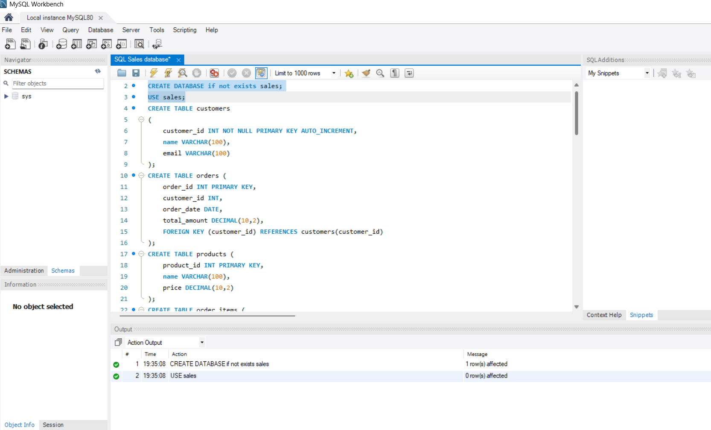
SELECT STATEMENT
INSERT INTO STATEMENT

Slide 3
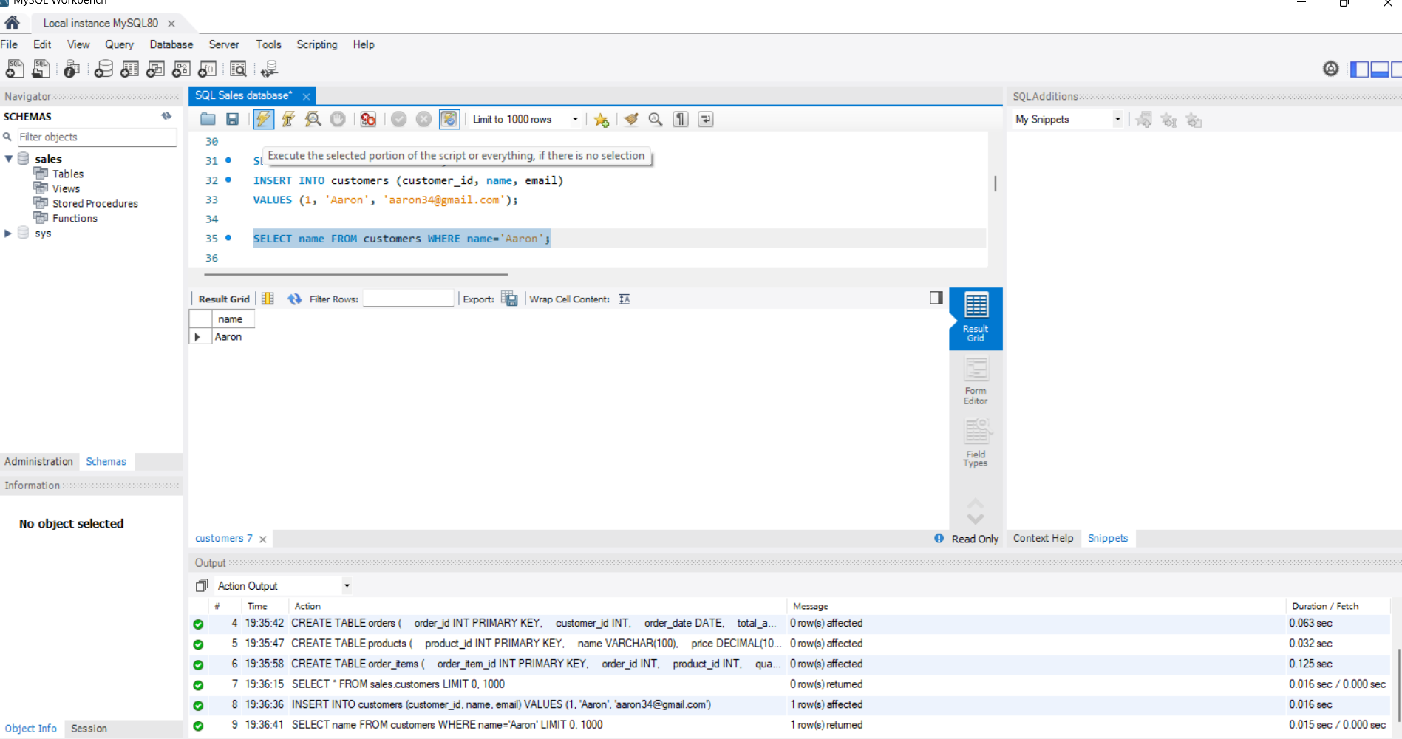
WHERE STATEMENT

Slide 4
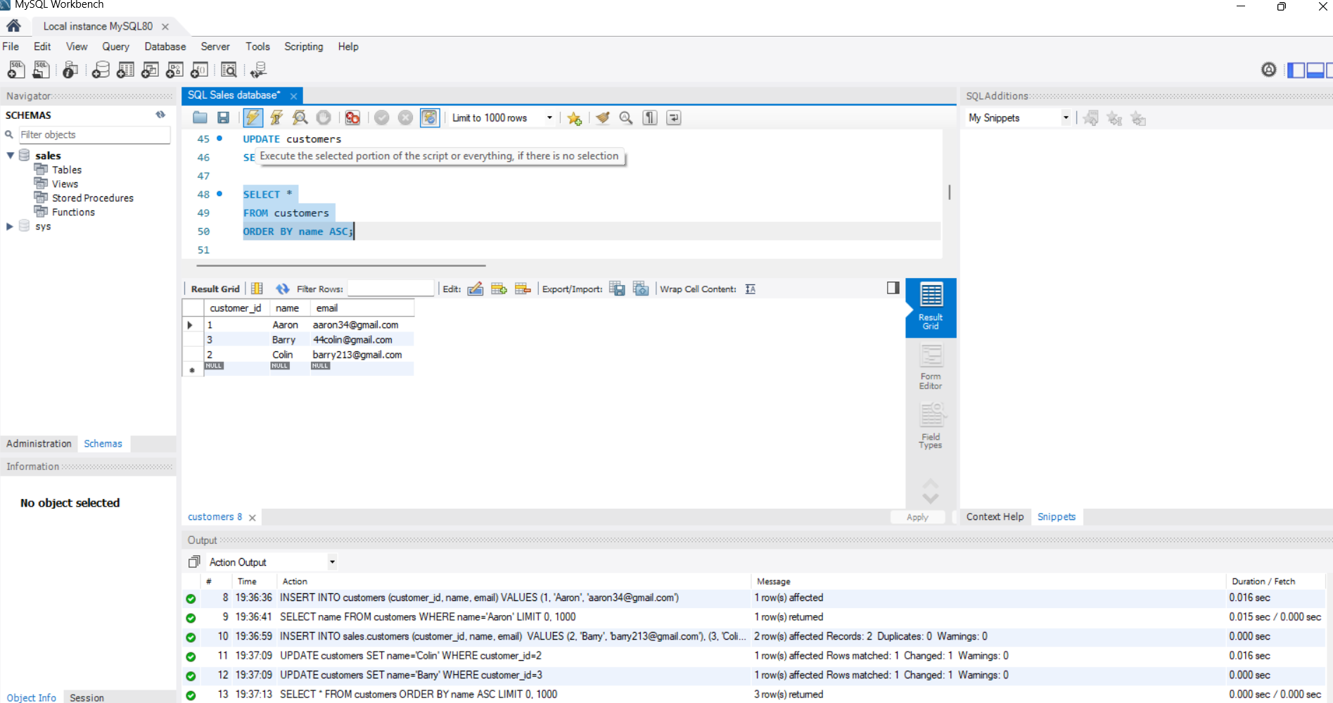
ORDER BY STATEMENT

Slide 5
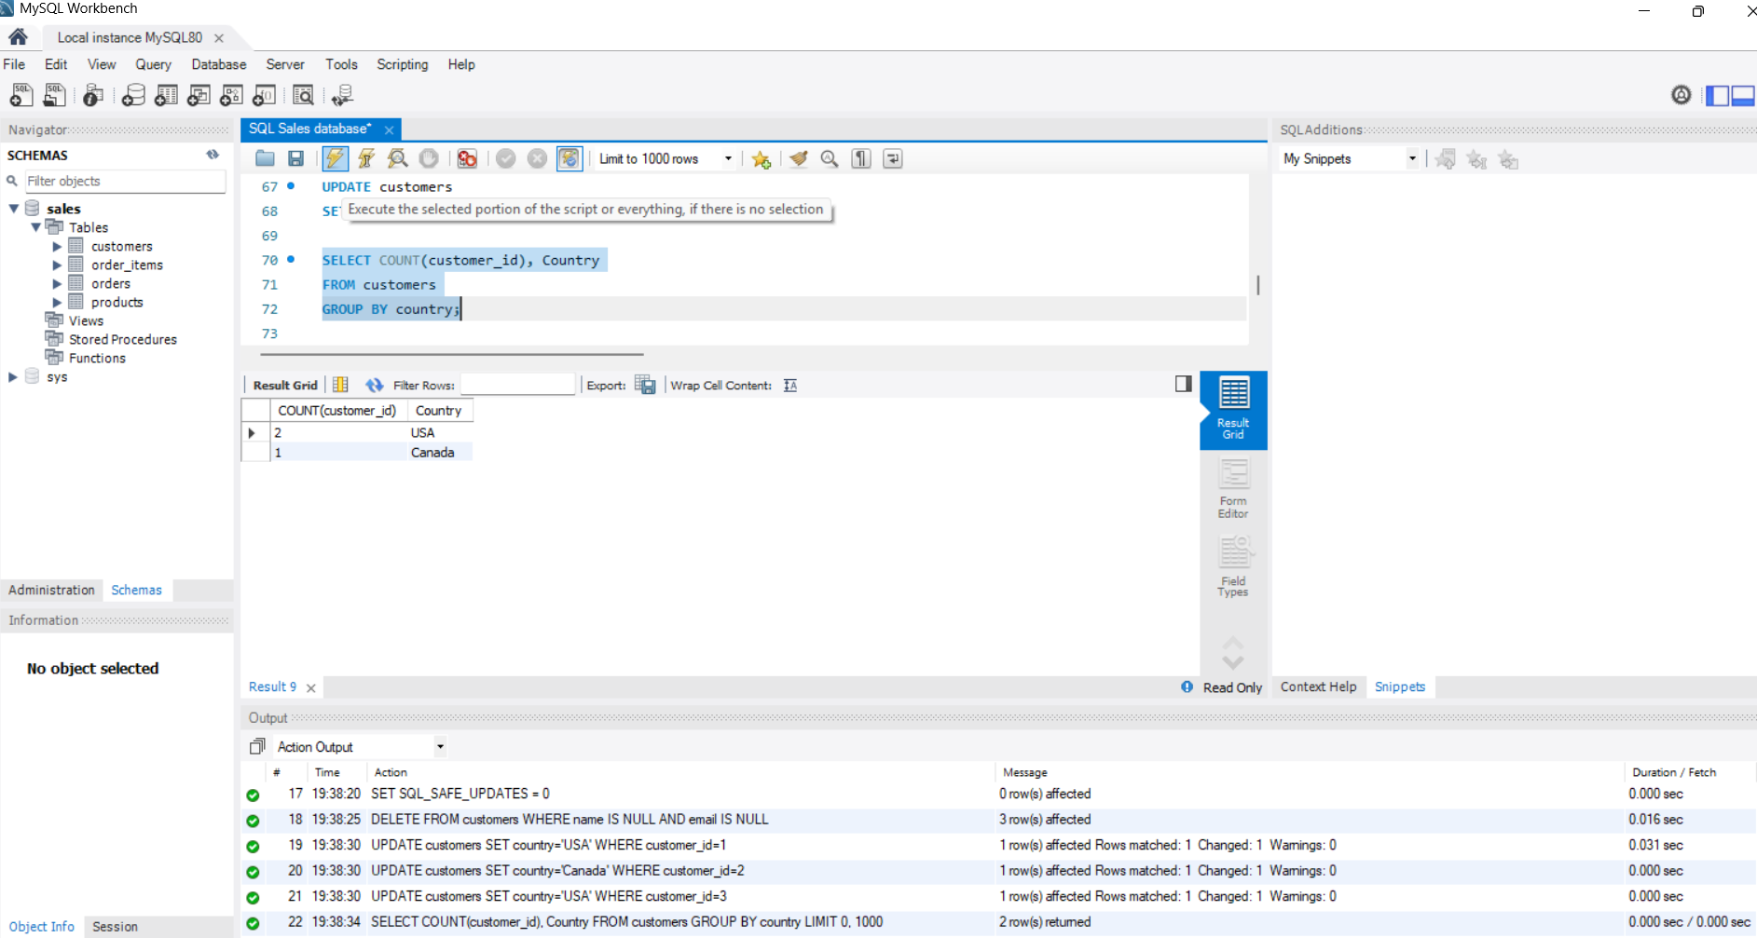
GROUP BY STATEMENT

Slide 6
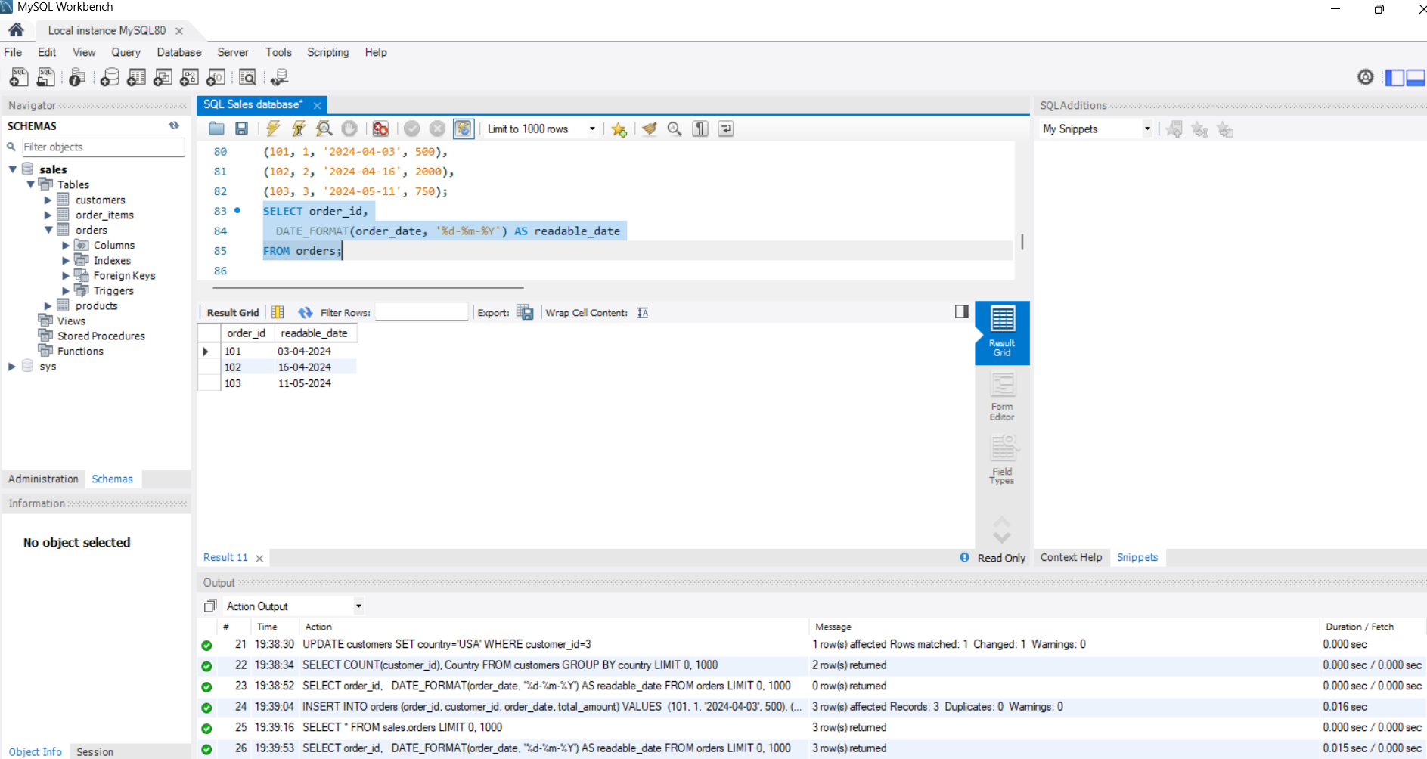
DATE FORMAT READING AS DD-MM-YYYY

Slide 7
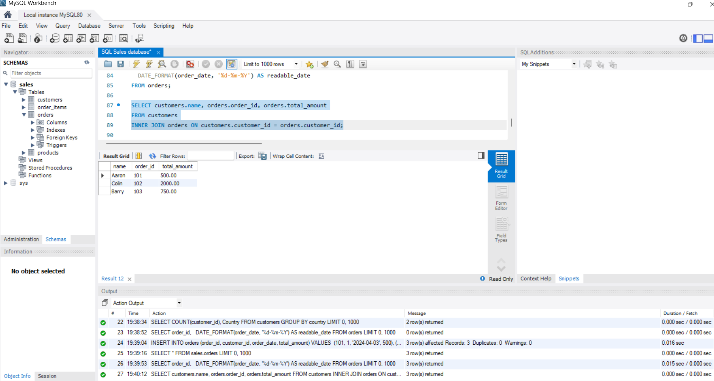
INNER JOIN STATEMENT

Slide 8
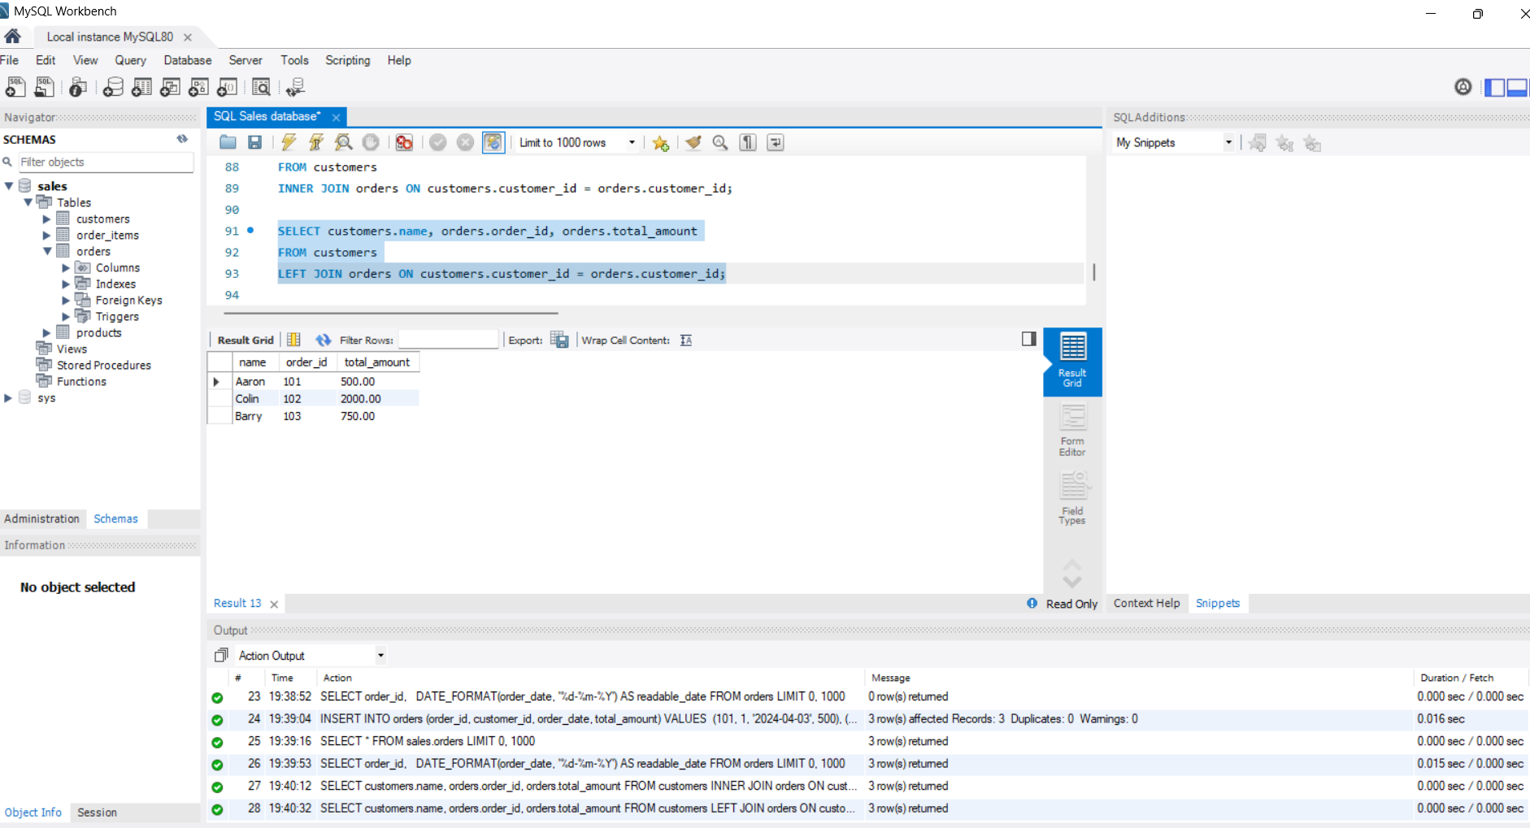
LEFT JOIN STATEMENT

Slide 9
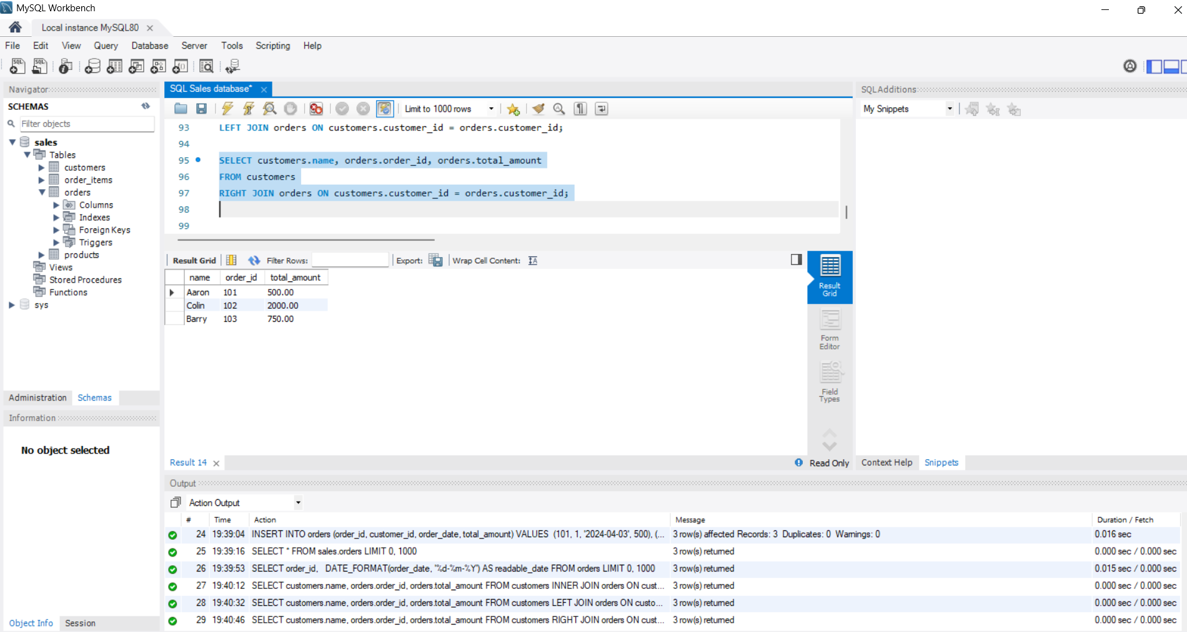
RIGHT JOIN STATEMENT

Slide 10
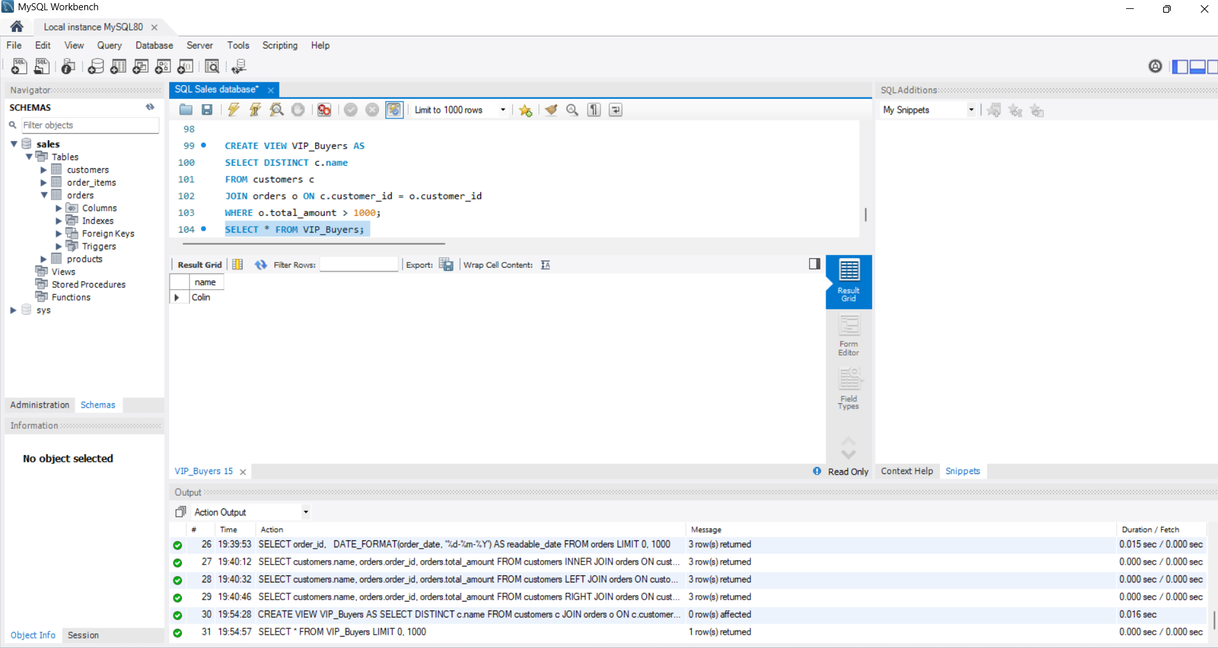
CREATE VIEW STATEMENT
Shows view of VIP buyers

